Slide 1
Support and Advocacy for Twice-Exceptional Students
Colette Hammons, Heather Hanlin, and Felicia Miyakawa
TENT: Twice-Exceptional Network of Texas
PATH Symposium
September 24, 2016

Slide 2
What is tent?
Twice
Exceptional
Network of
Texas
Formed in 2015 by parents of 2e kids in RRISD
We gather to support each other, share knowledge about advocacy and state / local policy
Goals: legislative advocacy, school advocacy, community education about 2e, continued parent support

Slide 3
What is 2e?
Simply put:
Intellectual Giftedness +
Learning Disability
=
Twice Exceptional

Slide 4
What is 2e?
High intelligence coupled with:
Learning Disabilities (dyslexia, dysgraphia, auditory processing disorder, etc.)
ADHD / ADD
Autism
Emotional or behavioral problems
And many other possibilities

Slide 5
Why worry about these kids in particular?
1. Potential
“Children at the far end of the IQ spectrum have the potential to take a number of life and career paths or to break new ground because of their innate abilities, but learning differences may severely limit their potential if not remediated, scaffolded and supported. -Gifted Homeschoolers Forum brochure, “Twice Exceptional: Smart Kids with Learning Differences”

Slide 6
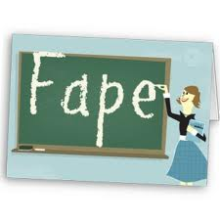
Why worry about these kids in particular?
2. Civil Rights:
Like all children, 2e kids have the right to a Free and Appropriate Public Education

Slide 7
Why worry about these kids in particular?
3. Community Resources:
Needs met = less struggle
Needs unmet =
Inappropriate coping strategies
Time and energy used ineffectively (at home and school)
Long term community outcomes
Chaos
Calm

Slide 8
How many 2e students are there?
How many students in gifted programs also have a learning disability?
6%-10% gifted students
About 19% of gifted students also have learning disabilities. *
*Karen Smart, “Thinking Smart about Twice Exceptional Learners”

Slide 9
How many 2e students are there?
How many students who receive SpEd services are also gifted?
13% of students in public schools are served by IDEA*
6% are also gifted (2e)** (2006)
*The National Center for Educational Statistics , May 2016
**National Education Association, The Twice Exceptional Dilemma (2006)
Note: 504 plans are not included in these estimates.

Slide 10
2e by the numbers
What would local school districts look like if we apply
13% IDEA and
6% gifted (2e)?

Slide 11
Eanes
Notes:
Data here from RRISD website, Leander ISD website, Eanes ISD website, and AISD Fact sheet (all 2015-2016 enrollment figures)

Slide 12
So according to national averages…
1,462 2e kids
So are they being identified?

Slide 13
Actual Data
Last year, there were 5,299,728 students enrolled in Texas public schools.
Using the same national averages, we should have 41,338 2e students in Texas.
Students served by IDEA in 2014-2015*
State Average: 8.5%
RRISD: 8.5%
Leander ISD: 9.7%
Eanes ISD: 7.9%
Austin ISD: 9.9% (rose to 10.2% last year)
Pflugerville ISD: 10.1%
Del Valle ISD: 9.2%
Lake Travis ISD: 7.0%
Georgetown ISD: 8.7%
Hutto ISD: 9.2%
*Source: TEA Reports for 2014-2015

Slide 14
But a caveat about this data
Doesn’t include children with 504 plans
No standard way of identifying 2e students, so they are difficult to find
Likely hiding in the general population, giftedness and disabilities masking each other.

Slide 15
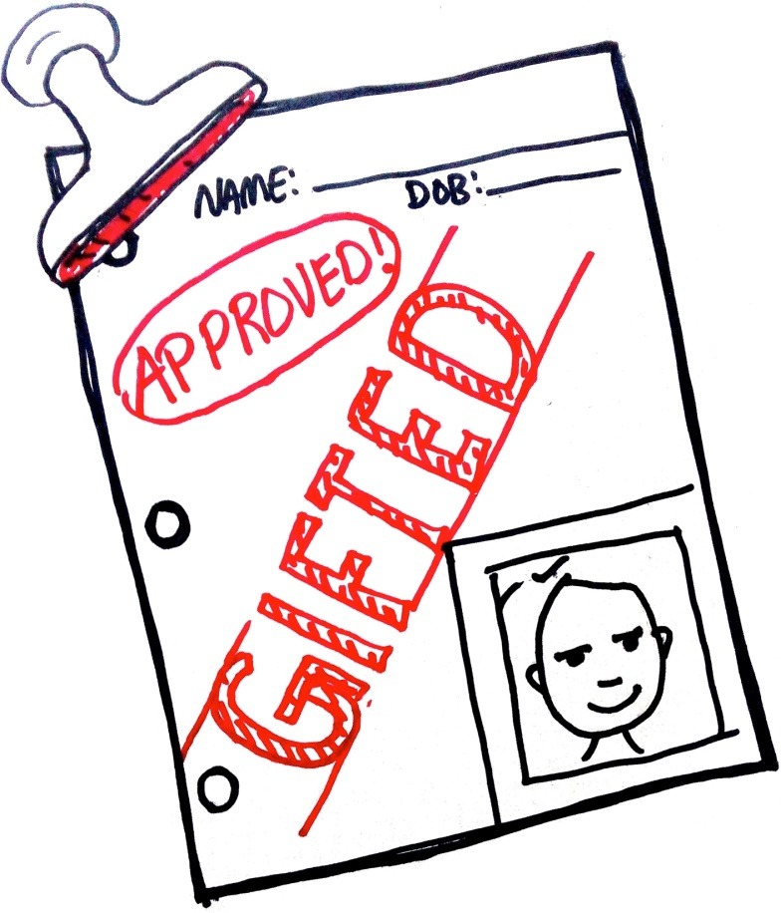
3 Types of 2e Students
Students identified as gifted but not LD.
large vocabulary and excellent verbal abilities
poor handwriting and spelling abilities.
May meet academic expectations, learning disability overlooked
Identification of disabilities could help "If I'm so smart, why is this so hard?"

Slide 16
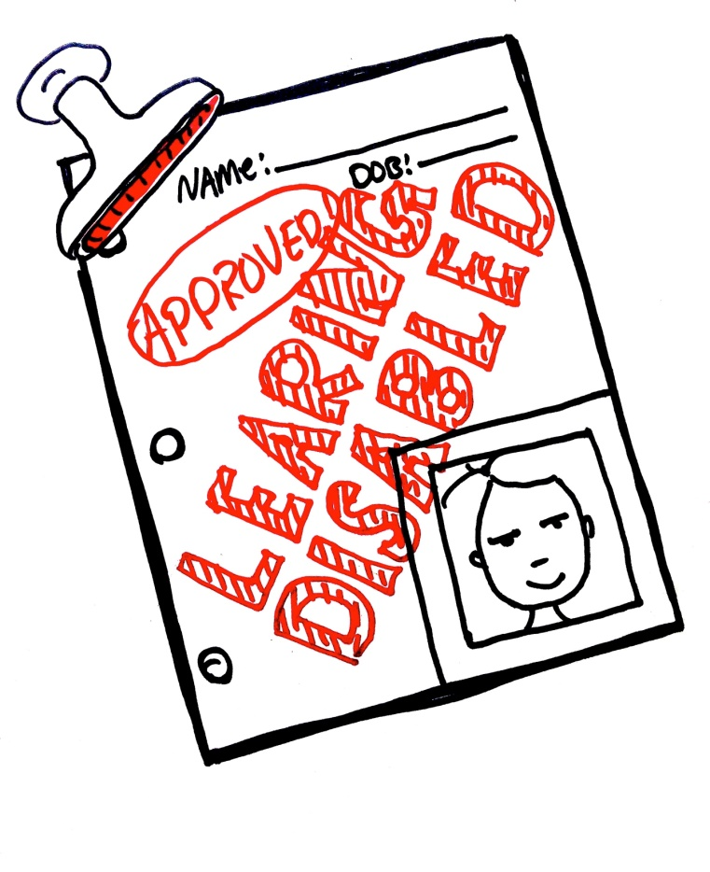
3 Types of 2e Students
2. Students identified as LD but not GT
disruptive classroom behavior
noticed only because of disability
little attention to strengths = feelings of failure
feelings of low self-concept

Slide 17
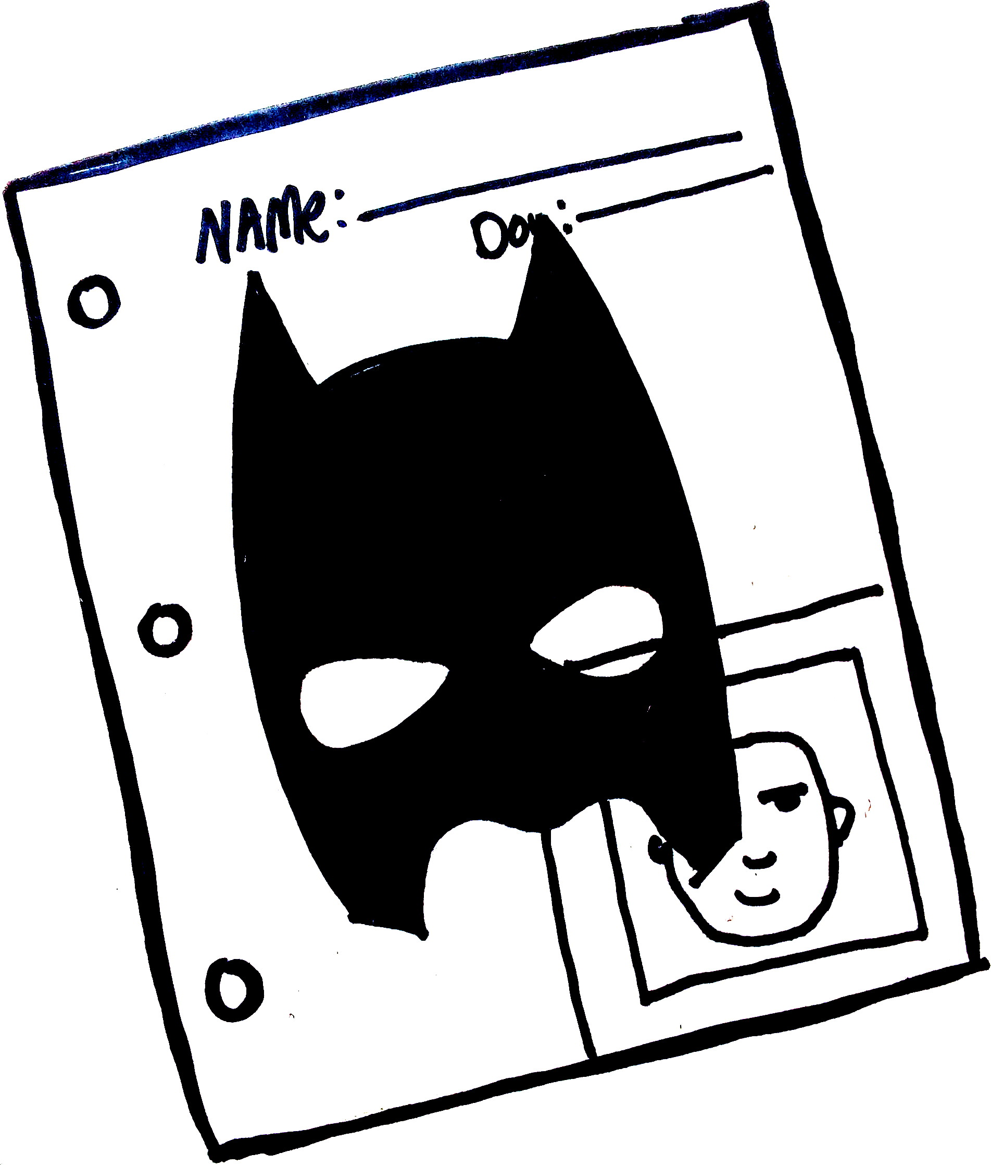
3 Types of 2e Students
3. Students who are unidentified.
Abilities and disabilities “mask” each other.
Perform at grade level, but below potential.
Talents in specific content areas, noticed later in life.
Possible mild depression

Slide 18
Long term Impacts of “Masking”
Risk of:
dropping out
Drug / alcohol use
low self-esteem / confidence
depression
Disruptive, daydreaming, or clowning behaviors
May be apathetic, angry, and highly self-critical.
May withdraw completely.
May procrastinate

Slide 19
Is your student 2e? What to Look for:
Uneven / asynchronous skills, such as:
Advanced ideas and opinions
Advanced problem-solving skills
Penetrating insight and wide range of interests
Sophisticated sense of humor
Lack of organization and study skills
Poor performance
Poor social skills
Sensitive to criticism
Behavior “problems”: high impulsivity, poor frustration tolerance, disruptive behavior in class, and stubborn or opinionated demeanor
Notes:
Other examples: superior vocabulary but difficulty with spelling, handwriting and / or written expression; Excellent leadership skills, but inconsistent response to auditory instructions / information

Slide 20
Advocating for YOUR 2e kid(s)
Find an ally in your school
“get-to-know-my-kid” letters
Give concrete suggestions
Research about 2e
For discussion: what has worked for you?

Slide 21
Advocating for 2e kids, the big picture
Get involved with your district’s GT parent advisory council and Special Education advisory council
Attend / participate in school board meetings
Advocate for new legislation (Texas has NO legal protection for GT or 2e kids)
For more about legislative advocacy, contact Felicia: FMMiyakawa@gmail.com
Notes:
-with new ESSA, more admin going back to state level. This will be a key year when it comes to adding to and revising state statutes. Contact Felicia (fmmiyakawa@gmail.com) if you want to help with this

Slide 22
Local resources
District Parent Advisory Councils
TENT (Twice-Exceptional Network of Texas)
PATH
Texas Parent to Parent
Disability Rights Texas

Slide 23
Resources
Idaho Department of Education, Twice Exceptional Manual
Montgomery County (Maryland) Public Schools, Twice Exceptional Students: A Staff Guidebook
Twice-Exceptional Gifted Children: Understanding, Teaching, and Counseling Gifted Students by Beverly Trail
The Mislabeled Child: Looking Beyond Behavior to Find the True Sources and Solutions for Children's Learning Challenges by Brock Eide
2e Newsletter (http://www.2enewsletter.com)
If This Is A Gift Can I Send It Back? : Surviving in the Land of the Gifted and Twice Exceptional by Jen Merrill
Equity in Gifted/Talented (G/T) Education (http://www.gtequity.org; website sponsored by Texas Education Agency)
National Center for Learning Disabilities (ld.org)
S. Baum, Gifted but Learning Disabled

Slide 24
Contact us
On the Web: Tent2e.weebly.com
By email:
Colette Hammons (coletteh2002@yahoo.com)
Heather Hanlin (heatherhanlin@gmail.com)
Felicia Miyakawa (FMMiyakawa@gmail.com)
TENT-Twice Exceptional Network of Texas

